Slide 1
Virtual Memory

Slide 2
A Simple View of Memory Hierarchy
CPU
word
Cache
block
Memory
page
Hard Disk
B.3 Six Basic Cache Optimizations
Notes:
when processor runs, programs or data that it requests may be in memory or hard disk.

Slide 3
Why Virtual Memory
Limited physical memory leads to complications
Size of a program is larger than main memory size
Memory demand of multiple programs is larger than main memory size
Observation: a program often needs to small part of memory during its execution
Load what is needed into main memory!
B.4 Virtual Memory
Notes:
IBM PC at 1980s only came with 64KB main memory.

Slide 4
Why Virtual Memory
Programs were divided into pieces and identified pieces that are mutually exclusive
These pieces were loaded and unloaded under user program control during execution
Calls between procedures in different modules lead to overlaying of one module with the other
Used to be done by hand
Significant burden on programmers
B.4 Virtual Memory
Notes:
Each program has its own virtual memory space.
Virtual M space is divided into blocks,
VM blocks are loaded if they are needed.
Fast program startup as not all blocks are loaded before exec.

Slide 5
Basics of Virtual Memory
Programs use virtual addresses (VA)
Memory uses physical addresses (PA)
VA → PA at the page granularity
pages can be anywhere in physical memory
or in disk
OS
App1
App2
…
…
…
Disk
B.4 Virtual Memory

Slide 6
Basics of Virtual Memory
Use physical DRAM as cache for disk
Address space of a process can exceed physical memory size
Sum of address spaces of multiple processes can exceed physical memory
Simplify memory management
Multiple processes resident in main memory
Each process with its own address space
Only “active” code and data is actually in memory
Allocate more memory to process as needed
Provide protection
One process can’t interfere with another
Because they operate in different address spaces
User process cannot access privileged information
Different sections of address space have different permissions
B.4 Virtual Memory

Slide 7
A Simplified View of Virtual Memory
Memory
0:
Page Table
1:
Virtual
Addresses
0:
1:
Physical
Addresses
CPU
P-1:
N-1:
Disk
B.4 Virtual Memory
Notes:
page/segment is the base unit of data transferred between memory and disk

Slide 8
Cache vs Virtual Memory
B.4 Virtual Memory
Notes:
Note that miss penalty of VM is much larger than that of cache.
Note that in virtual memory, access time is much higher than transfer time

Slide 9
Cache vs Virtual Memory
Terminology
Block → page
Cache miss → page fault
Replacement on cache memory misses by hardware whereas virtual memory replacement is by OS
Size of processor address determines size of VM whereas cache size is independent of address size
VM can have fixed or variable size blocks
page vs segmentation: they both have pros and cons
B.4 Virtual Memory

Slide 10
Virtual Memory Design Issues
Page size should be large enough to try to amortize high access time of disk
Typical size: 4KB – 16KB
Reducing page fault rate is important
Fully associative placement of pages in memory
Page faults not handled by hardware
OS can afford to use clever algorithm for page replacement to reduce page fault rate
Write-through approach is too expensive
Write back approach is always used
B.4 Virtual Memory
Notes:
note that disk access time is much higher than transfer time -> large page size.
But large page size can lead to waste of memory.

Slide 11
Virtual Memory Address Translation
From CPU
n–1
p
p–1
0
virtual address
[n-1..0]
virtual page number
page offset
Address Translation
m–1
p
p–1
0
physical address
[m-1..0]
physical page number
page offset
To memory
B.4 Virtual Memory
Notes:
size of page offset is determined by page size

Slide 12
Address Translation
page table base register
virtual address
n–1
p
p–1
0
virtual page number (VPN)
page offset
valid
access
physical page number (PPN)
if valid=0 then page is not in memory
m–1
p
p–1
0
physical page number (PPN)
page offset
physical address
Each process has its own page table.
B.4 Virtual Memory

Slide 13
Address Translation - Example
Page Table base register
0xFFFF87F8
Virtual Page Number
Page Offset
1111 1111 1010 1000
1010 1111 1101 1100
0
…
…
…
1111 1010 1111
1111 1111 1111 1111
…
page table
Physical Address:
1111 1010 1111
1010 1111 1101 1100
Physical Page Number
Page Offset
B.4 Virtual Memory

Slide 14
Review the cache optimization
Avoid Address Translation during Cache Indexing to Reduce Hit Time

Slide 15
Page Faults
What if object is on disk rather than in memory?
Page table entry indicates virtual address not in memory
OS exception handler invoked to move data from disk into memory
Current process suspends, others can resume
OS has full control over placement, etc.
Before fault
After fault
Memory
Memory
Page Table
Virtual
Addresses
Physical
Addresses
Page Table
Virtual
Addresses
Physical
Addresses
CPU
CPU
Disk
B.4 Virtual Memory
Disk

Slide 16
Servicing Page Faults
(1) Initiate Block Read
Processor signals controller
Read block of length P starting at disk address X and store starting at memory address Y
Read occurs
Direct Memory Access (DMA)
Under control of I/O controller
I/O controller signals completion
Interrupt processor
OS resumes suspended process
Processor
Reg
(3) Read Done
Cache
Memory-I/O bus
(2) DMA Transfer
I/O
controller
Memory
disk
disk
Disk
Disk
B.4 Virtual Memory
Notes:
More on this in OS course.

Slide 17
Page Replacement
When there are no available free pages to handle a fault, we must find a page to replace.
This is determined by the page replacement algorithm.
The goal of the replacement algorithm is to reduce the fault rate by selecting the best victim page to remove.
Again, due to high access latency to disk
LRU is the most popular replacement policy.
Each page is associated with a use/reference bit.
It is set whenever a page is accessed.
OS periodically clears these bits.
Pages with the use bit reset are candidates for replacement
B.4 Virtual Memory

Slide 18
Fast Address Translation – TLB
tags from VAs
Physical page number
B.4 Virtual Memory
Notes:
Virtually addressed physically tagged L1 cache – parallel TLB and L1 access.
Explain what happens on TLB misses, L1/L2 misses.

Slide 19
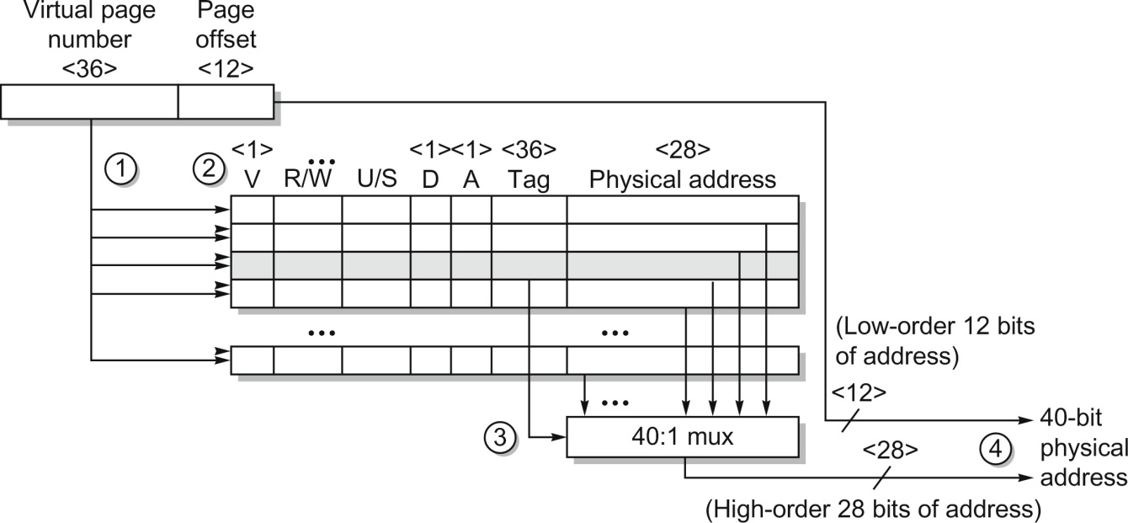
TLB in AMD Opteron
Figure B.24 Operation of the Opteron data TLB during address translation. The four steps of a TLB hit are shown as circled numbers. This TLB has 40 entries. Section B.5 describes the various protection and access fields of an Opteron page table entry.
B.4 Virtual Memory
Notes:
this TLB is fully associative

Slide 20
Question: Page size and Page Table Size
Assume 32-bit virtual address
Page table size if page size is 4K?
Page table size if page size is 16K?
What about 64-bit virtual address?
B.4 Virtual Memory

Slide 21
Multi-Level Page Table
Virtual address
Higher level PTEs point to lower level tables
PTEs at bottom level hold PPN
Different parts of VAs used to index tables at different levels
Notes:
# of levels of page table hierarchy depends on the size of virtual addresses

Slide 22
Multi-Level Page Table
Virtual address
Large VA space is unused
If a entry in level L is null, the tables at lower levels (those to the right) are not stored in memory

Slide 23
Selecting Page Size – Large Page Size
Smaller page table
A page table can occupy a lot of space
Larger L1 cache
Less TLB misses, faster translation
More efficient to transfer larger pages from 2nd storage
Wasted memory usage
Wasted IO bandwidth
Slower process start up
B.4 Virtual Memory

Slide 24
Virtual Memory – Protection
Virtual memory and multiprogramming
Multiple processes sharing processor and physical memory
Protection via virtual memory
Keeps processes in their own memory space
only OS can update page tables
Role of architecture:
Provide user mode and supervisor mode
Protect certain aspects of CPU state: PC, register, etc
Provide mechanisms for switching between user mode and supervisor mode
Provide mechanisms to limit memory accesses
Provide TLB to translate addresses
B.5 Protection of Virtual Memory

Slide 25
Page Table Entries – Protection
Address – physical page number
Valid/present bit
Modified/dirty bit
Reference bit
For LRU
Protection bits – Access right field defining allowable accesses
R/W/X: read only, read-write, execute only
User/Supervisor

Slide 26
Page Table Entries – Protection
Check bits on each access and during a page fault
If violated, generate exception (Access Protection exception)

Slide 27
Summary
OS virtualizes memory and IO devices
Each process has an illusion of private CPU and memory
Virtual memory
Arbitrarily large memory, isolation/protection, inter-process communication
Reduce page table size
Translation buffers – cache for page table
Manage TLB misses and page faults
Protection

